Slide 1

Project title:-
Propeller LED display
Group no : 31
Chincholkar Apoorv R. 0932016
Joshi Sanket S. 0932044
Gore Rigved B. 0932032

Slide 2
Block Diagram
IR
Sensor
MOC7811
Micro
controller
Beam
Interrupt
In each
revolution
LED
Display
AT89C2051
5 V DC
Regulated
power supply
DC
motor

Slide 3
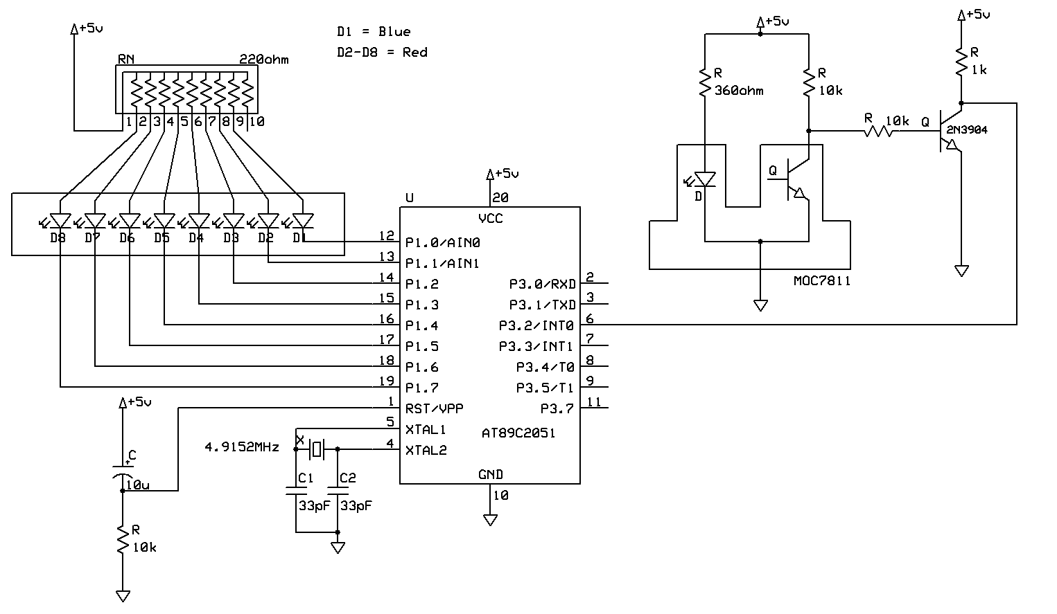
Circuit Diagram

Slide 4
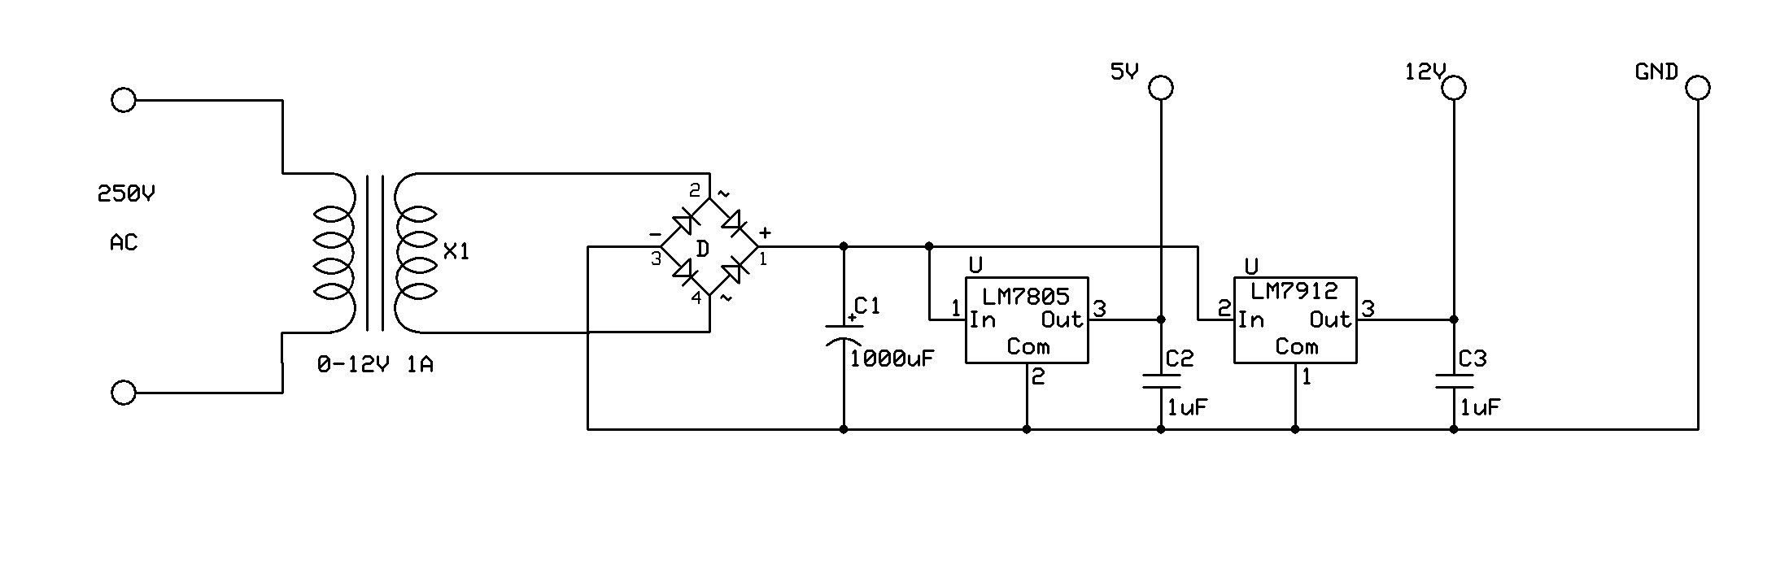
Power Supply

Slide 5
Construction
Circuit
LEDs
MOC7811
5V
GND

Slide 6
Introduction
What is Propeller LED Display???
Propeller is a term generally associated with rotating fan , revolving at high RPM. Just like a propeller, this is a special kind of a rotating display.
How it works???
PERSISTANCE OF VISION
This is a phenomenon of the eye by which an afterimage is thought to persist for approximately 1/25th of a second. So if someone is observing images at rate of 25 images/second, they appear to be continuous.
Confused???

Slide 7
A picture is worth a thousand words…..
propeller LED display

Slide 8
Component Selection
Microcontroller :
Requirements: -> Moderate speed
-> Ports required : 2
-> Small Sized
-> Code memory > 1kB
Component Selected: Atmel AT89C2051
_______________________________________________________________
Sensor :
Requirements: -> IR type sensor preferred
-> Easy to interface with microcontroller
-> Minimum requirement of external components
Component Selected : Motorola MOC7811 interrupt sensor

Slide 9
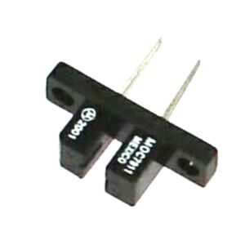
The Sensor
Sensor used in this project is MOC 7811 from
Motorola. This is a slotted coupler/interrupter device.
In each revolution as the beam is interrupted,
the sensor generates a positive pulse. Microcontroller
will execute interrupt routine, When a pulse occurs.
Interrupt routine measures the total time taken for one revolution, divides it by 120, and stores the result into another timer,
Configured in auto-reload mode.
Now, the timer overflows after tiny intervals of time. Each time it overflows, next stored value is called from the lookup table, and displayed.

Slide 10
START
Measure period of one revolution with T0
Divide by 120
Load the result in T1 with auto reload mode.
After each timer overflow interrupt, display next value from lookup table

Slide 11
THANK YOU!!!

